Slide 1
55-604708: Project(Technical Computing)
Ethics, marking and moderation

Slide 2

Ethics - why?
No-one wants to stop you doing the project that you want to do
Research ethics are not just a personal matter – they are a concern to professional and funding bodies, public ‘profile’ or ‘image’ of SHU, and ultimately the value of your degree
Bad ethics is usually bad research – and consequently a weak mark for your FYP
https://www.shu.ac.uk/research/excellence/ethics-and-integrity

Slide 3
How?
We have to use the UREC forms - a university-wide ethical checklist system
The 4 levels of ethics clearance available here, https://www.shu.ac.uk/research/excellence/ethics-and-integrity/approvals2
UREC1 – research with no human participants
UREC2 – low risk research with human participants
UREC3 – higher risk social science type research with human participants
UREC4 – Higher risk bio-medical, food, sport and health studies
For undergraduate projects we advise against NHS ethics clearance and young or vulnerable human participants (UREC 3&4).
Most projects will require the UREC2 form.
This system was new last year. It may be that you have to lead this process with your supervisor.

Slide 4

Remember: Several different views are possible
Ethics are culturally specific
Ethics are historically specific
Ethics are influenced by many religions
Therefore this is a 'moving target'
Changes with time and place
If you'd like to find out more:
'Ethics - A Very Short Introduction', Simon Blackburn, OUP, 2003

Slide 5
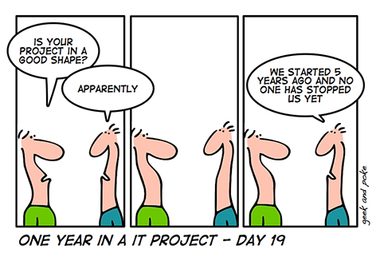
Research Ethics - 'Helsinki Declaration' (1964)
Informed Consent
Confidentiality
Beneficence (an act of charity, mercy, and kindness with a strong connotation of doing good )
Non-malfeasance (avoid any act or plan that would harm the or violate trust - in other words do no harm)
Widely recognised
Perfect for your FYP (and IT projects generally)

Slide 6
Some Specific ICT Issues
Privacy
Ownership (IP)
Theft (both IP and data)
Viruses
Unauthorised access
Free speech
Safety
BCS Code of Conduct
and others …

Slide 7
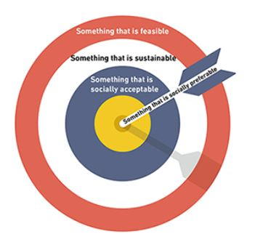
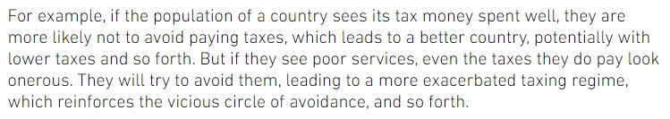
Some Examples (not to do)
I want to write a computer virus as part of my FYP
In my FYP I want to investigate security loopholes in a particular computer system (by trying to breach security)
For my FYP I want to develop a computer game using notably tasteless scenarios and images that might offend many / any people
I want to build an application for my FYP that covertly monitors electronic communications

Slide 8
Ethics
You are asked to complete an UREC ethics checklist as part of the project.
If you answer 'yes' to any of the questions you MUST discuss this with your supervisor. It will probably mean you need to modify your project.
If your project tutor cannot sign off the form, escalate the form to the project co-ordinator. Or agree to modify your project.
If there is a large ethical part to your project you might want to discuss this in an additional section in your project specification (and the final report).

Slide 9
Marking the project

Slide 10
What get's marked
you hand in
a submission to Turnitin of the main body of the report (this gets checked for plagiarism)
an electronic version of the complete and final report on Bb, front cover and all appendices
a video demonstrating your deliverable.
your deliverable to either Bb or the Q drive (Q:\ACESStudent\55-604708_Project_Technical_Computing\<studentID>)
SUMMARY
TURNITIN COMPLETE COPY OF REPORT
VIDEO DELIVERABLE

Slide 11
How does it get marked?
Report is read by two people: your supervisor and one other person (you will know who it is soon and it will be the same person who moderates your specification)
One other good reason to stay in touch with your supervisor
guide the write-up
not seeing you can create a bad impression & low expectations... (typically, well-founded)
The other person doesn't know the project so provides a more independent perspective.
REMEMBER THIS WHEN YOU WRITE...
Target audience?
What do they know? What do you need to explain?
Both readers use the same marking scheme...

Slide 12
Marking Scheme (See Bb site)
Module has learning outcomes
What you are expected to know/be able to do at the end of the module
These are:
self-manage a significant piece of work, by
carrying out an in-depth investigation of the context and literature and, where appropriate, other similar products;
identifying, selecting and applying appropriate tools, techniques and approaches to the relevant project;
applying an engineering approach to the development of at least one significant computer-based artefact, to produce a set of deliverables by which the success of the piece of work can be judged.
research, critically reflect on and clearly communicate issues relevant to project success, professional and ethical concerns and aspects of personal development planning (PDP).
passing means judging how well you have met those outcomes...

Slide 13
The deliverable
50% of the mark for the deliverable
Producing a set of deliverables by which the success of the piece of work can be judged.
Marking should address the following:
Does the deliverable meet the aims of the project and the target audience?
Were suitable and relevant engineering approaches/processes used?
Has the success of the project been measured?
What is the quality of the deliverable and its video?
What is the difficulty of the deliverable?
How complete is the deliverable?
Is it well described in the documentation?
Was the demonstration of the work convincing?
What is the marker's assessment of the quality of the deliverable?
How can they tell?
can look at the eVersion supplied but is it guaranteed to run?
will they get all the nuances (that you forgot to write about)
It's what the video and the demo/walkthrough is for
not formally marked but has a clear (almost always) positive influence.

Slide 14
Time Management
What can you do to make sure you don't leave your project until the last minute?
Keep a diary
Make voice recordings
Allocate a set time each week to work on your project

Slide 15
What next?
Decide what you are going to do for your project.
Find a supervisor - by October 14th (if you don't I'll allocate one to you).
Write and submit (to BB) a project spec
Other Support
Drop in Sessions: On your timetables
A selection of 2.1 and first class project reports from previous years are available on BB.
1-to-1 research support with Simon Quinn: Time and format yet to be decided but will be published on BB.
Supervisor meetings - typically ½ hour every 2 weeks
Start of Semester 2
Critical Evaluation and Report Writing lecture

Slide 16
Good luck
And any questions?

